Slide 1
Are there Fragile Regions in the Human Genome? Combinatorial Algorithms
Phillip Compeau and Pavel Pevzner
Bioinformatics Algorithms: an Active Learning Approach
©2013 by Compeau and Pevzner. All rights reserved

Slide 2
Are There Fragile Regions in the Human Genome?
Transforming Men into Mice
Sorting by Reversals
Breakpoint Theorem
Rearrangements in Tumor Genomes
2-Break Distance Problem
Breakpoint Graphs
2-Break Distance Theorem
Rearrangement Hotspots in the Human Genome
Synteny Block Construction
Notes:
Whitehead Inst. got 16 blocks on X; distance=13.

Slide 3
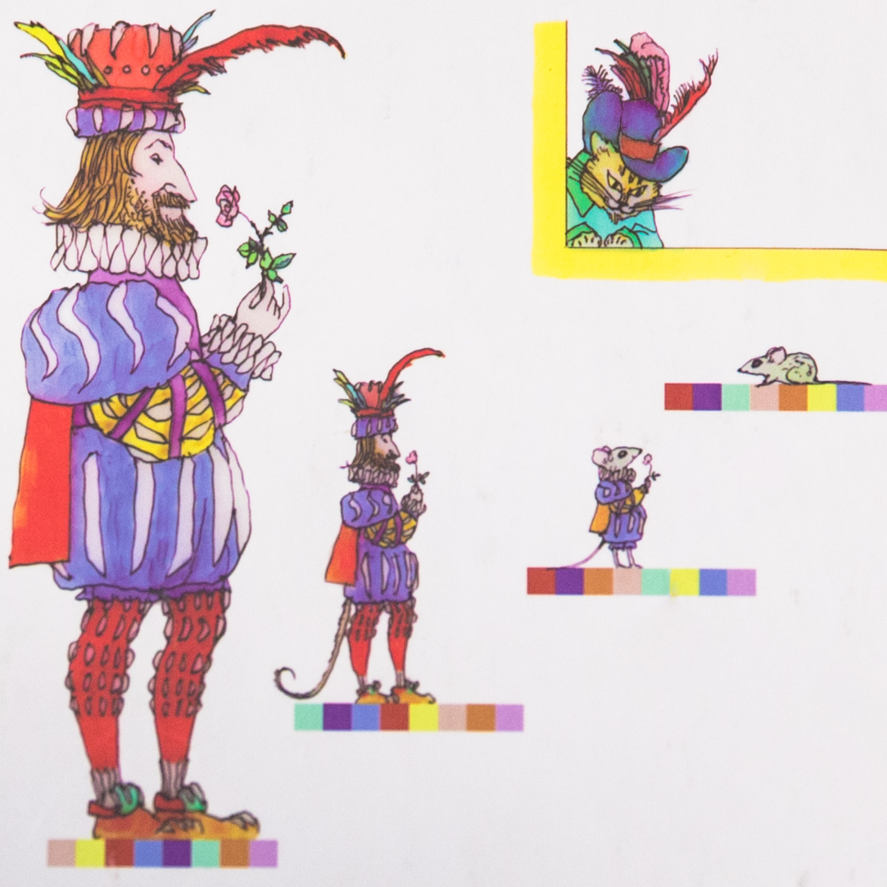
Notes:
Whitehead Inst. got 16 blocks on X; distance=13.

Slide 4

Genome Rearrangements
Mouse (X chromosome)
Unknown ancestor ~ 75 million years ago
Human (X chromosome)
What are the similarity blocks and how to find them?
What is the evolutionary scenario for transforming one genome into the other?
Notes:
hour

Slide 5
Genome rearrangements
Mouse (X chromosome)
Unknown ancestor ~ 75 million years ago
Human (X chromosome)
What are the similarity blocks and how to find them?
What is the evolutionary scenario for transforming one genome into the other?
Notes:
hour

Slide 6
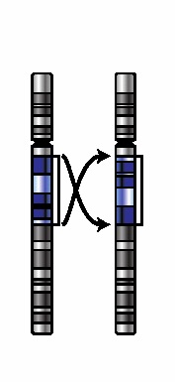
Transforming Mice into Men
Notes:
Whitehead Inst. got 16 blocks on X; distance=13.

Slide 7
Series of Reversals
Notes:
Whitehead Inst. got 16 blocks on X; distance=13.

Slide 8
Series of Reversals
Notes:
Whitehead Inst. got 16 blocks on X; distance=13.

Slide 9
Series of Reversals
Notes:
Whitehead Inst. got 16 blocks on X; distance=13.

Slide 10
Series of Reversals
Notes:
Whitehead Inst. got 16 blocks on X; distance=13.

Slide 11
Series of Reversals
Notes:
Whitehead Inst. got 16 blocks on X; distance=13.

Slide 12
Series of Reversals
Notes:
Whitehead Inst. got 16 blocks on X; distance=13.

Slide 13
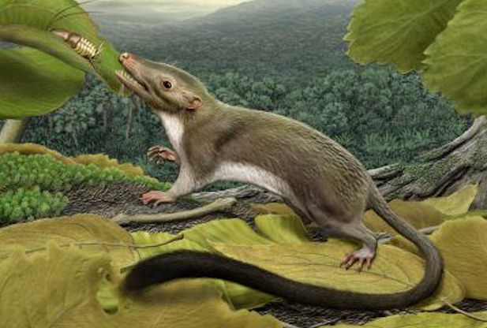
Human-Mouse Transformation Accomplished!
back in time
forward in time
Notes:
Whitehead Inst. got 16 blocks on X; distance=13.

Slide 14
Transforming mice into men (X chromosome)
+1 -2 +3 -4 +5 -6 +7 -8 -9 +10 +11
+1 +7 +9 +11 +10 +3 +2 +6 +5 -4 +8
Notes:
Whitehead Inst. got 16 blocks on X; distance=13.

Slide 15
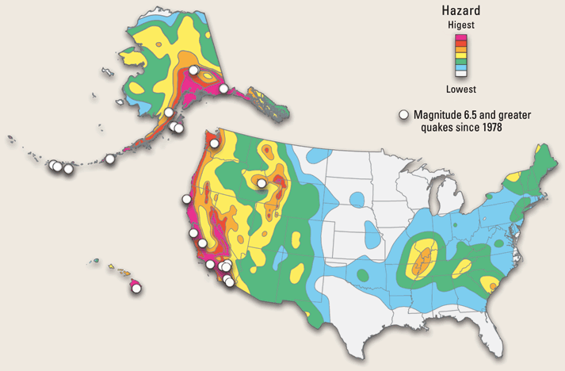
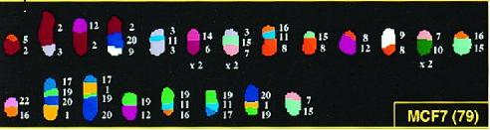
Evolutionary Earthquakes
Are there any rearrangement hotspots in mammalian genomes?
Notes:
hour

Slide 16
Are There Any Rearrangement Hotspots in This Scenario?
Notes:
Whitehead Inst. got 16 blocks on X; distance=13.

Slide 17
Are There Any Rearrangement Hotspots in This Scenario?
Earthquake!
Earthquake!
Notes:
Whitehead Inst. got 16 blocks on X; distance=13.

Slide 18
Are There Any Rearrangement Hotspots in This Scenario?
Earthquake!
Earthquake!
Notes:
Whitehead Inst. got 16 blocks on X; distance=13.

Slide 19
Are There Any Rearrangement Hotspots in This Scenario?
Earthquake!
Earthquake!
Notes:
Whitehead Inst. got 16 blocks on X; distance=13.

Slide 20
Are There Any Rearrangement Hotspots in This Scenario?
Earthquake!
Earthquake!
Notes:
Whitehead Inst. got 16 blocks on X; distance=13.

Slide 21
A Rearrangement Hotspots Found!
Rearrangement hotspot
Earthquake!
Earthquake!
Notes:
Whitehead Inst. got 16 blocks on X; distance=13.

Slide 22
More Rearrangement Hotspots
Rearrangement hotspots
Notes:
Whitehead Inst. got 16 blocks on X; distance=13.

Slide 23

Random Breakage Model of Chromosome Evolution
Susumu Ohno, 1973: Rearrangements occur at random positions (no fragile regions).
Nadeau & Taylor, 1984: the first statistical arguments in favor of the Random Breakage Model (RBM).

Slide 24
Does RBM Have Predictive Power?
Apply N random reversals to a chromosome consisting of M “genes.” Can we predict how many blocks of length k will be generated?
If we can predict it, will these predictions fit what we observe in real genomes?

Slide 25
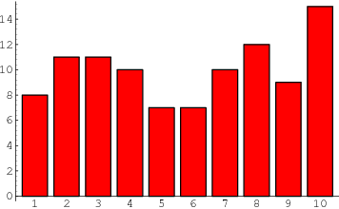
Does RBM Have Predictive Power?
Apply N random reversals to a chromosome consisting of M “genes.” Can we predict how many blocks of length k will be generated?
number of blocks
block size

Slide 26
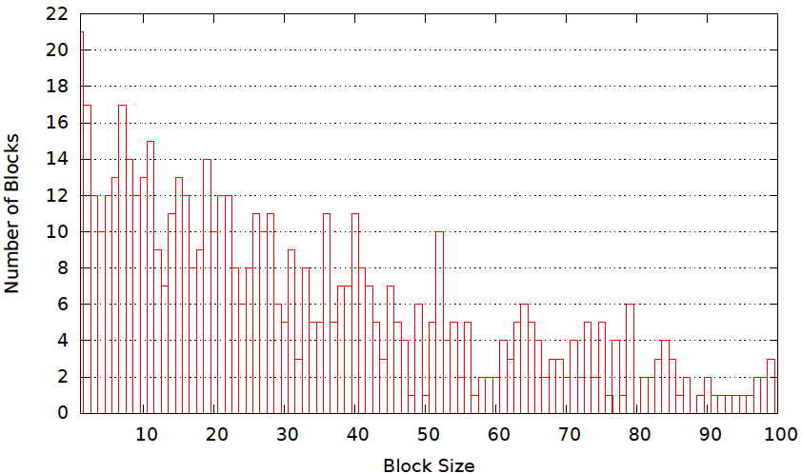
Does RBM Have Predictive Power?
Apply N random reversals to a chromosome consisting of M “genes.” Can we predict how many blocks of length k will be generated?
320 reversals 25,000 genes
If we can predict it, will these predictions fit what we observe in real genomes?
Despite the fact that reversals occur at random positions, we can predict (roughly) how many blocks of each length will be generated!

Slide 27
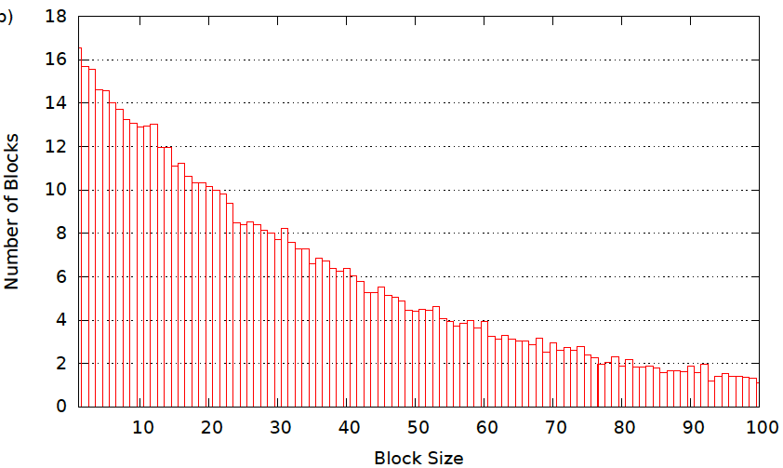
Histogram of Synteny Block Lengths (averaged over 100 simulations)

Slide 28
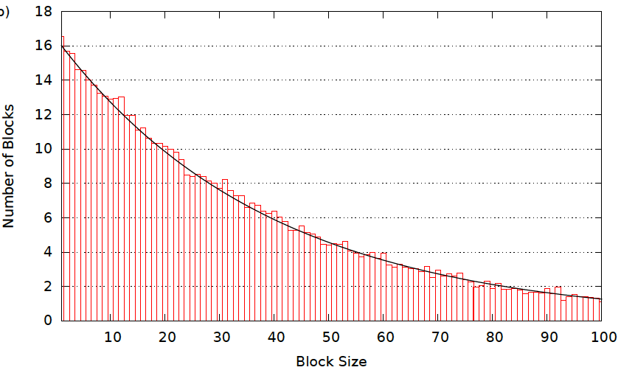
Exponential Distribution (simulated data)
y=λe^{-λ∙x}

Slide 29
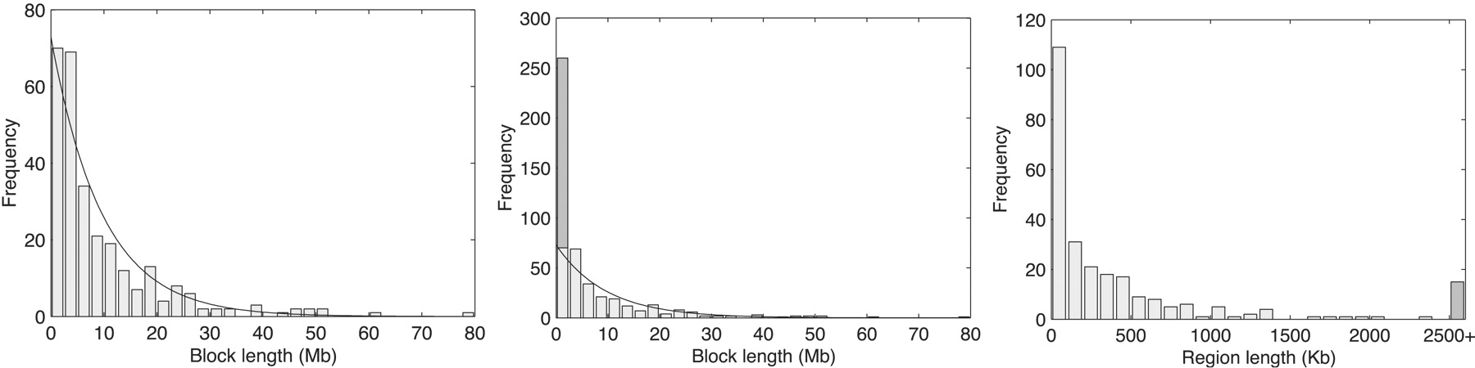
Lengths of Real Human-Mouse Synteny Blocks
y=λe^{-λ∙x}
1990s: RBM was embraced by biologists and has become de facto theory of chromosome evolution.

Slide 30
Are There Fragile Regions in the Human Genome?
Transforming Men into Mice
Sorting by Reversals
Breakpoint Theorem
Rearrangements in Tumor Genomes
2-Breaks
Breakpoint Graphs
2-Break Distance Theorem
Rearrangement Hotspots in the Human Genome
Synteny Block Construction
Notes:
Whitehead Inst. got 16 blocks on X; distance=13.

Slide 31
Reversals
1
2
3
9
10
8
4
7
5
6
+1 +2 +3 +4 +5 +6 +7 +8 +9 +10

Slide 32
Reversals
1
2
3
9
10
8
4
7
5
6
+1 +2 +3 +4 +5 +6 +7 +8 +9 +10

Slide 33
Reversals
1
2
3
9
10
8
4
7
5
6
+1 +2 +3 -8 -7 -6 -5 -4 +9 +10

Slide 34
Reversals
1
2
3
9
10
8
4
7
5
6
+1 +2 +3 -8 -7 -6 -5 -4 +9 +10
The reversal introduced two breakpoints (disruptions in gene order).

Slide 35
Rearrangement Scenario with 5 Reversals
Notes:
hour

Slide 36
Rearrangement Scenario with 4 Reversals
Reversal distance: the minimum number of reversals to transform one permutation into another.

Slide 37
Sorting by 4 Reversals
Sorting by Reversals Problem: Calculate the reversal distance between a permutation and the identity permutation (+1 +2 … +n).
Input: A permutation P.
Output: The reversal distance between P and the identity permutation.
Reversal Distance Problem: Calculate the reversal distance between two permutations.
Input: Two permutations.
Output: The reversal distance between them.

Slide 38
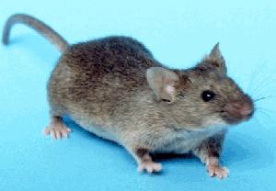
Greedy Sorting by Reversals
(+1 -7 +6 -10 +9 -8 +2 -11 -3 +5 +4)

Slide 39

Greedy Sorting by Reversals
(+1 -7 +6 -10 +9 -8 +2 -11 -3 +5 +4)
(+1 -2 +8 -9 +10 -6 +7 -11 -3 +5 +4)
(+1 +2 +8 -9 +10 -6 +7 -11 -3 +5 +4)
(+1 +2 +3 +11 -7 +6 -10 +9 -8 +5 +4)
(+1 +2 +3 -4 -5 +8 -9 +10 -6 +7 -11)
(+1 +2 +3 +4 -5 +8 -9 +10 -6 +7 -11)
(+1 +2 +3 +4 +5 +8 -9 +10 -6 +7 -11)
(+1 +2 +3 +4 +5 +6 -10 +9 -8 +7 -11)
(+1 +2 +3 +4 +5 +6 -7 +8 -9 +10 -11)
(+1 +2 +3 +4 +5 +6 +7 +8 -9 +10 -11)
(+1 +2 +3 +4 +5 +6 +7 +8 +9 +10 -11)
(+1 +2 +3 +4 +5 +6 +7 +8 +9 +10 +11)

Slide 40
Are there Fragile Regions in the Human Genome?
Transforming Men into Mice
Sorting by Reversals
Breakpoint Theorem
Rearrangements in Tumor Genomes
2-Breaks
Breakpoint Graphs
2-Break Distance Theorem
Rearrangement Hotspots in the Human Genome
Synteny Block Construction
Notes:
Whitehead Inst. got 16 blocks on X; distance=13.

Slide 41

Adjacencies and Breakpoints
0
15
+3 +4 +5 -12 -8 -7 -6 +1 +2 +10 +9 -11 +13 +14
in order
in order
despite being inverted
out of order
adjacencies(P) + breakpoints(P)=|P|+1
What is the number of breakpoints in the identity permutation
(+1 +2 … +n)?

Slide 42
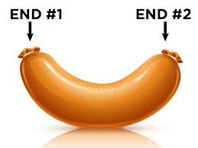
Sorting by Reversals as Breakpoint Elimination
breakpoints(P)
6
4
4
2
0
How many breakpoints can be eliminated by a single reversal?
Breakpoint Theorem: Reversal distance ≥ breakpoints(P)/2
Hint:

Slide 43
Are There Fragile Regions in the Human Genome?
Transforming Men into Mice
Sorting by Reversals
Breakpoint Theorem
Rearrangements in Tumor Genomes
2-Breaks
Breakpoint Graphs
2-Break Distance Theorem
Rearrangement Hotspots in the Human Genome
Synteny Block Construction
Notes:
Whitehead Inst. got 16 blocks on X; distance=13.

Slide 44
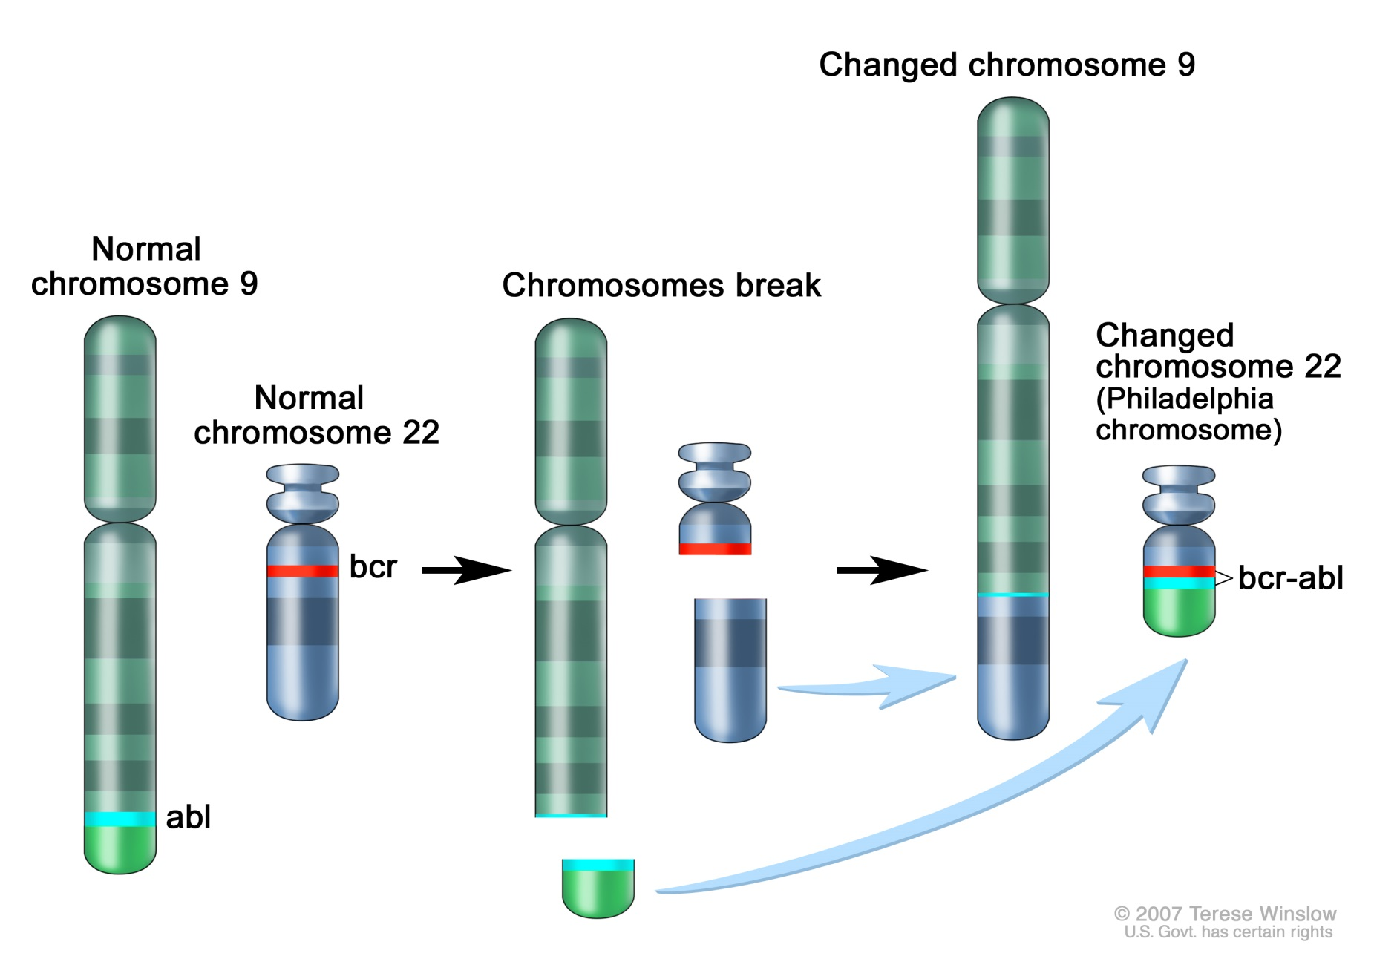
Philadelphia Chromosome

Slide 45
Philadelphia Chromosome

Slide 46
Philadelphia Chromosome
Oncogenic bcr-abl fusion gene:
biomarker for chronic myeloid leukemia (CML)

Slide 47

Translocations
Translocation in CML yields Philadelphia chromosome:
Chr 9
ABL gene
Chr 22
BCR gene
Thousands of rearrangements known for different tumors.

Slide 48
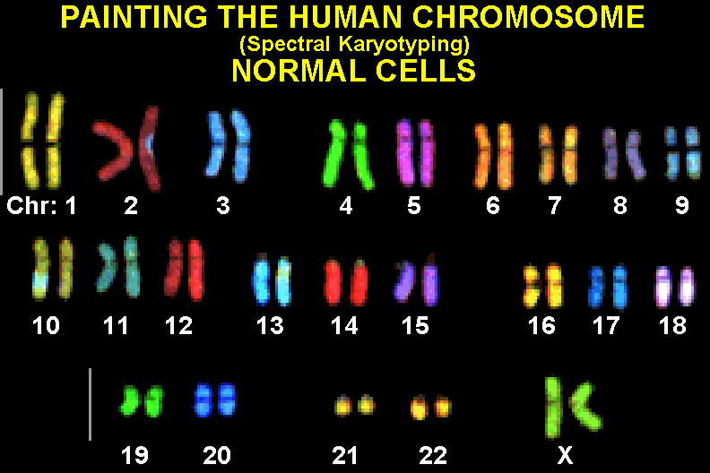
Painting Chromosomes (Normal Cells)

Slide 49
Painting Chromosomes (Tumor Cells)
MCF7 is human breast cancer cell line:
What sequence of rearrangements has produced MCF7?

Slide 50
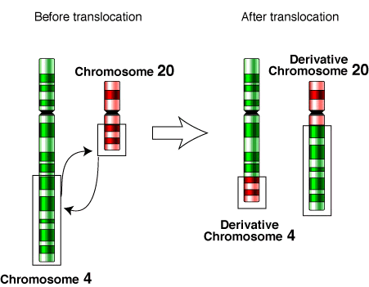

Rearrangements in Multichromosomal Genomes
translocations
fusions and fissions
Besides reversals
and translocations:
there are also fusions and fissions of chromosomes.
(+5 +9 +4 +8) (–6 –1 +7 –2)
(+5 +9 +7 –2) (–6 –1 +4 +8)
(1 2) (3 4 5)
(1 2 3 4 5)

Slide 51
Are There Fragile Regions in the Human Genome?
Transforming Men into Mice
Sorting by Reversals
Breakpoint Theorem
Rearrangements in Tumor Genomes
2-Break Distance Problem
Breakpoint Graphs
2-Break Distance Theorem
Rearrangement Hotspots in the Human Genome
Synteny Block Construction
Notes:
Whitehead Inst. got 16 blocks on X; distance=13.

Slide 52
From Linear to Circular Chromosomes
(+a –b –d +c) (+e +f +g +h +i +j)

Slide 53
From Linear to Circular Chromosomes
f
e
b
g
a
d
j
h
c
i
(+a –b –d +c) (+e +f +g +h +i +j)
Black directed edges represent synteny blocks.

Slide 54
From Linear to Circular Chromosomes
f
e
b
g
a
d
j
h
c
i
(+a –b –d +c) (+e +f +g +h +i +j)
Black directed edges represent synteny blocks.
Red undirected edges connect adjacent synteny blocks.

Slide 55
Equivalent Representations of a Circular Genome
b
b
=
a
d
a
c
c
d
Q=(+a-b-d+c) Q=(+a-b-d+c)

Slide 56
Reversals on Circular Chromosomes
b
b
reversal
a
c
a
c
d
d
P=(+a-b-c+d) Q=(+a-b-d+c)
A reversal deletes two red edges and replaces them by two other red edges (on the same 4 nodes)

Slide 57
Fusion/Fission as Replacement of Two Red Edges
b
b
fission
a
c
a
c
fusion
d
d
P=(+a-b-c+d) Q= (+a-b) (-c+d)
2-break: a rearrangement that replaces two red edges with two new red edges on the same 4 nodes.

Slide 58
Translocation on linear chromosomes
-a +b +c -d
-a +f -g +h
+e +f -g +h
+e +b +c -d
Translocation on circularized chromosomes
d
●
●
d
d
c
a
c
a
c
a
b
2-break
b
b
Circularization
Linearization
●
e
●
e
e
h
f
h
f
h
f
g
g
g

Slide 59
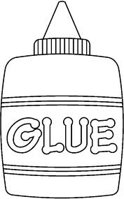
-a +b +c -d
-a +f -g +h
+e +f -g +h
+e +b +c -d
Translocation on linear chromosomes
d
●
●
d
c
a
c
a
Circularization
of linear
chromosomes
b
2-break
b
●
e
●
e
h
f
h
f
g
g

Slide 60
-a +b +c -d
-a +f -g +h
+e +f -g +h
+e +b +c -d
d
●
d
c
a
c
a
Circularization
of linear
chromosomes
b
2-break
b
Linearization
of circular
chromosomes
●
e
e
h
f
h
f
g
g

Slide 61
2-Break Distance
2-Break distance d(P,Q):
minimum number of 2-breaks transforming genome P into genome Q
2-Break Distance Problem. Find the 2-break distance between two genomes.
Input. Two genomes on the same set of synteny blocks.
Output. The 2-break distance between these genomes.

Slide 62
Are There Fragile Regions in the Human Genome?
Transforming Men into Mice
Sorting by Reversals
Breakpoint Theorem
Rearrangements in Tumor Genomes
2-Break Distance Problem
Breakpoint Graphs
2-Break Distance Theorem
Rearrangement Hotspots in the Human Genome
Synteny Block Construction
Notes:
Whitehead Inst. got 16 blocks on X; distance=13.

Slide 63
Comparing Genomes P and Q
b
a
P
c
d
c
a
Q
b
d

Slide 64
Different Drawing of Q
b
a
P
c
b
d
a
c
c
Q
d
a
Q
b
d

Slide 65
Superimposing P and Q
b
BreakpointGraph(P,Q)
a
P
c
b
d
a
c
c
d
a
Q
b
d

Slide 66
Red and Black Edges in Breakpoint Graph Form..
b
BreakpointGraph(P,Q)
a
P
c
b
d
a
c
c
d
a
Q
b
d

Slide 67
Blue and Black Edges in Breakpoint Graph Form…
b
BreakpointGraph(P,Q)
a
P
c
b
d
a
c
c
d
a
Q
b
d

Slide 68
What About Red and Blue Edges???
b
BreakpointGraph(P,Q)
a
P
c
b
d
a
c
c
d
a
Q
b
d

Slide 69
Alternating Red-Blue Cycles
BreakpointGraph(P,Q)
b
Red and blue edges form
alternating red-blue cycles.
a
c
d
cycle(P,Q): number of red-blue alternating cycles

Slide 70
Breakpoint Graph
b
b
BreakpointGraph(P,Q)
a
P
c
a
P
c
b
d
d
a
c
c
b
Q
d
a
Q
b
a
c
d
d

Slide 71
a
f
b
P
e
c
d
What is cycle(P,Q)?
Q
a
b
e
c
d
f

Slide 72
a
f
b
P
e
c
d
Arranging blacks edges of Q
in the same order as black edges in P
Q
a
a
f
b
Q
b
e
c
d
e
c
f
d

Slide 73
a
f
b
P
BreakpointGraph(P,Q)
e
a
c
f
d
b
e
c
d
Q
a
a
f
b
b
e
c
d
e
c
f
d

Slide 74
a
f
b
P
BreakpointGraph(P,Q) cycle(P,Q)=3
e
a
c
f
d
b
e
c
d
Q
a
a
f
b
b
e
c
d
e
c
f
d

Slide 75
Given P, What Genome Q Maximizes cycle(P,Q)?
b
a
c
d
P=(+a-b-c+d)

Slide 76
Given P, What Genome Q Maximizes cycle(P,Q)?
BreakpointGraph(P,P)
b
Identity
Breakpoint
Graph
a
c
cycle(P,P)=#blocks=4
d
P=(+a-b-c+d)

Slide 77
Genome Rearrangements Affect Red-Blue Cycles
Each transformation P Q corresponds to a transformation:
BreakpointGraph(P,Q) BreakpointGraph(Q,Q)
b
b
Series of 2-breaks transforming P into Q
a
c
a
c
d
d
cycle(P,Q)=2 cycle(Q,Q)= 4

Slide 78
Genome Rearrangements Affect Red-Blue Cycles
Each transformation P ➔ Q
corresponds to a transformation
BreakpointGraph(P,Q) ➔ BreakpointGraph(Q,Q)
b
b
series of 2-breaks transforming P into Q
a
c
a
c
d
d
cycle(P,Q)=2 cycle(Q,Q)= 4

Slide 79
Rearrangements Change cycle(P,Q)
P=(+a –b –c +d) → P’=(+a –b –c -d) → P’’=Q=(+a +c +b -d)
BreakpointGraph(P,Q) → BreakpointGraph(P’,Q) → BreakpointGraph(Q,Q)
cycle(P,Q)=2 → cycle(P’,Q)=3 → cycle(Q,Q)=4
‏
‏
c
c
c
a
b
a
b
a
b
d
d
d

Slide 80
Rearrangements Change cycle(P,Q)
P=(+a –b –c +d) → P’=(+a –b –c -d) → P’’=Q=(+a +c +b -d)
BreakpointGraph(P,Q) → BreakpointGraph(P’,Q) → BreakpointGraph(Q,Q)
cycle(P,Q)=2 → cycle(P’,Q)=3 → cycle(Q,Q)=4
‏
‏
c
c
c
a
b
a
b
a
b
d
d
d

Slide 81
Are There Fragile Regions in the Human Genome?
Transforming Men into Mice
Sorting by Reversals
Breakpoint Theorem
Rearrangements in Tumor Genomes
2-Break Distance Problem
Breakpoint Graphs
2-Break Distance Theorem
Rearrangement Hotspots in the Human Genome
Synteny Block Construction
Notes:
Whitehead Inst. got 16 blocks on X; distance=13.

Slide 82
Sorting by 2-Breaks
2-breaks
P → ... → Q
BreakpointGraph(P,Q) → ... → BreakpointGraph(Q,Q)
cycle(P,Q) → ... → cycle(Q,Q)=blocks(Q,Q)
# of red-blue cycles increases by blocks(P,Q) - cycle(P,Q)
How much each 2-break can contribute to this increase?

Slide 83
A 2-Break May Change cycle(P,Q) by …
cycle(P,Q)
does not change
cycle(P,Q)
increases by 1
cycle(P,Q)
decreases by 1

Slide 84
Each 2-Break Increases #Cycles by at Most 1
A 2-break:
adds 2 new red edges and thus creates at most 2 new cycles (containing two new red edges)
removes 2 red edges and thus destroys at least 1 old cycle (containing two old edges)
change in the number of cycles ≤ 2-1=1.

Slide 85
There Exists a 2-Break Increasing cycle(P,Q) by 1
cycle(P,Q)
does not change
cycle(P,Q)
increases by 1
cycle(P,Q)
decreases by 1

Slide 86
2-Break Distance Theorem
A 2-break increases #cycles by at most 1.
There exists a 2-break increasing #cycles by 1.
Every sorting by 2-breaks must increase #cycles by
blocks(P,Q) - cycle(P,Q)
2-break distance between genomes P and Q:
d(P,Q) = blocks(P,Q) - cycle(P,Q)

Slide 87
2-Break Distance between Human and Mouse Genomes
Human and Mouse genomes can be decomposed into 280 synteny blocks (at least 0.5 million nucleotides in length)
The breakpoint graph on these blocks has 35 cycles
The 2-break distance between Human and Mouse:
d(H,M) = blocks(H,M)-cycle(H,M) = 280-35=245
There are numerous 245-step scenarios.
The true scenario may have more than 245 steps.

Slide 88
Are There Fragile Regions in the Human Genome?
Transforming Men into Mice
Sorting by Reversals
Breakpoint Theorem
Rearrangements in Tumor Genomes
2-Break Distance Problem
Breakpoint Graphs
2-Break Distance Theorem
Rearrangement Hotspots in the Human Genome
Synteny Block Construction
Notes:
Whitehead Inst. got 16 blocks on X; distance=13.

Slide 89
Are There Fragile Regions in the Human Genome?

Slide 90
Are There Fragile Regions in the Human Genome?
Rearrangement Hotspots Theorem: Yes!

Slide 91
Are There Fragile Regions in the Human Genome?
Rearrangement Hotspots Theorem: Yes!
Proof: If the Random Breakage Model is correct, then N rearrangements applied to circular chromosomes will produce approximately 2N synteny blocks.
Since there are 280 human-mouse synteny blocks, there must have been approximately 280/2 = 140 2-breaks on the human-mouse evolutionary path.
However, the 2-Break Distance Theorem implies that there are at least 245 2-breaks on this path.
STOP and Think. Is 245 ≈ 140?

Slide 92
A Contradiction!
Since 245 is much larger than 140, we arrived at a contradiction implying that one of our assumptions is incorrect! Which one?
But the only assumption we made in this proof was:
“If the Random Breakage Model is correct…”

Slide 93
If RBM Is Wrong, How Would You Explain the Exponential Distribution?
Notes:
# clumps of b.p. w/in .668 Mb in uniform distrib expected to be 43, vs. our 190 b.p. re-uses.

Slide 94
Computational Tests vs. Biological Models
Why have biologists embraced the Random Breakage Model?
Test

Slide 95
Computational Tests vs. Biological Models
Why have biologists embraced the Random Breakage Model?
A logical fallacy: RBM is not the only model that complies with the “exponential distribution” test.
 | Exponential distribution
RBM | YES
Test
Model

Slide 96
Computational Tests vs. Biological Models
Why have biologists embraced the Random Breakage Model?
A logical fallacy: RBM is not the only model that complies with the “exponential distribution” test.
Why was RBM refuted?
It does not comply with the observed “breakpoint reuse.”
 | Exponential distribution | Breakpoint reuse
RBM | YES | NO
Test
Model

Slide 97
A New Model Needed
Why have biologists embraced the Random Breakage Model?
A logical fallacy: RBM is not the only model that complies with the “exponential distribution” test.
Why was RBM refuted?
It does not comply with the “breakpoint reuse” observed in genomes.
Is there a model that complies with both the “exponential distribution” and the “breakpoint reuse” tests?
 | Exponential distribution | Breakpoint reuse
RBM | YES | NO
??? | YES | YES
Test
Model

Slide 98
Fragile Breakage Model
Genome is a mosaic of:
fragile regions with high propensity for rearrangements
and
solid regions with low propensity for rearrangements.
Fragile regions (regions between consecutive synteny blocks) are small, accounting for less than ~ 5% of genome.
Notes:
# clumps of b.p. w/in .668 Mb in uniform distrib expected to be 43, vs. our 190 b.p. re-uses.

Slide 99
Does FBM Explain BOTH Exponential Distribution and Rearrangement Hotspots?
A small number of short fragile regions explain rearrangement hotspots.
If the fragile regions are somewhat randomly distributed throughout the genome, the synteny blocks lengths follow the exponential distribution!
 | Exponential distribution | Breakpoint reuse
RBM | YES | NO
FBM | YES | YES
Test
Model
Notes:
# clumps of b.p. w/in .668 Mb in uniform distrib expected to be 43, vs. our 190 b.p. re-uses.

Slide 100
But Is There a Test that BOTH RBM and FBM Fail?
 | Exponential distribution | Breakpoint reuse | A New Test?
RBM | YES | NO | NO
FBM | YES | YES | NO
Test
Model

Slide 101
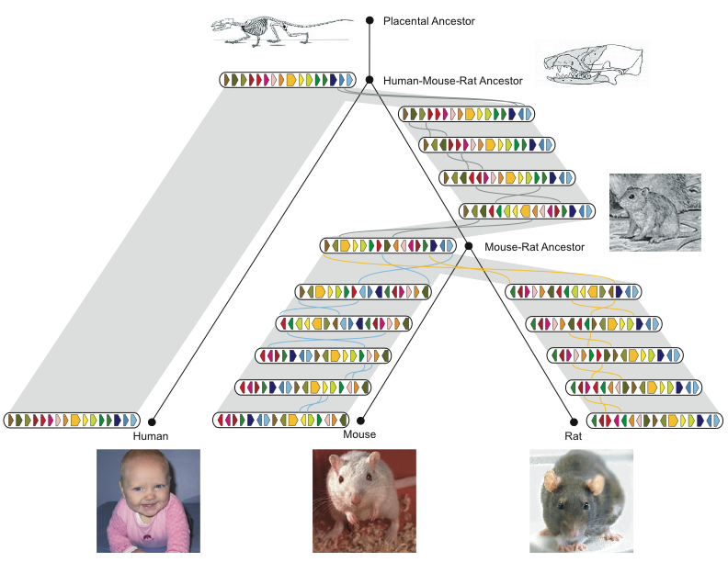
Information About Multiple Genomes Enables a New Test
Multiple Breakpoint Reuse Test:
analysis of breakpoints across multiple genomes
 | Exponential distribution | Breakpoint reuse | A New Test?
RBM | YES | NO | NO
FBM | YES | YES | NO
Test
Model

Slide 102
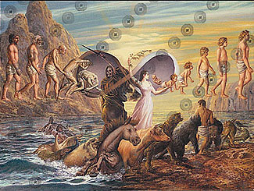
Birth and Death of Fragile Regions
Recent studies revealed evidence for the “birth and death” of the fragile regions, implying that they move to different locations in different lineages.
This discovery resulted in the Turnover Fragile Breakage Model (TFBM) that complies with a new Multiple Breakpoint Reuse (MBR) Test.
TFBM points to locations of the currently fragile regions.
Test

Slide 103
Birth and Death of Fragile Regions
Recent studies revealed evidence for the “birth and death” of the fragile regions, implying that they move to different locations in different lineages.
This discovery resulted in the Turnover Fragile Breakage Model (TFBM) that complies with a new Multiple Breakpoint Reuse (MBR) Test.
TFBM points to locations of the currently fragile regions.
 | Exponential distribution | Breakpoint reuse | MBR
RBM | YES | NO | NO
FBM | YES | YES | NO
TFBM | YES | YES | YES
Test
Test
Model

Slide 104
Where Are the Fragile Regions Located? What Causes Fragility?
Notes:
# clumps of b.p. w/in .668 Mb in uniform distrib expected to be 43, vs. our 190 b.p. re-uses.

Slide 105
Are There Fragile Regions in the Human Genome?
Transforming Men into Mice
Sorting by Reversals
Breakpoint Theorem
Rearrangements in Tumor Genomes
2-Break Distance Problem
Breakpoint Graphs
2-Break Distance Theorem
Rearrangement Hotspots in the Human Genome
Synteny Block Construction
Notes:
Whitehead Inst. got 16 blocks on X; distance=13.

Slide 106
How Do We Construct the Synteny Blocks?
Mouse (X chromosome)
Unknown ancestor ~ 75 million years ago
Human (X chromosome)
Notes:
hour

Slide 107
Comparing Genome with Itself (in 2-D)
T
G
T •
C •
C •
C •
T •
C •
T •
A •
T •
T •
G •
G •
A •
C •
G •
A •
A G C A G G T T A T C T C C C T G T
Identical k-mers
(k=3)

Slide 108
From Identical 3-mers to Identical 2-mers
T
G
T •
C • •
C •
T • •
T •
C • •
T • •
A •
T •
T •
G •
G •
A • •
C •
G •
A • •
A G C A G G T T A T C T T C C T G T
Identical k-mers
(k=2)

Slide 109
From Identical 3-mers to Identical 2-mers
T
G
T •
C • •
C •
T • •
T •
C • •
T • •
A •
T •
T •
G •
G •
A • •
C •
G •
A • •
A G C A G G T T A T C T T C C T G T
•
•
•
•

Slide 110
We Forgot about the Complementary Strand
A-T
C-G
A-T •
G-C • •
G-C • •
A-T •
A-T •
G-C •
A-T •
T-A •
A-T •
A-T •
C-G •
C-G •
T-A • •
G-C • •
C-G •
T-A •
A G C A G G T T A T C T T C C T G T
| | | | | | | | | | | | | | | | | |
T C G T C C A A T A G A A G G A C A
Identical and
reverse
complementary
k-mers (k=3).

Slide 111
Comparing Different Genomes
A-T
C-G
A-T •
G-C • •
G-C • •
T-A •
T-A
T-A
A-T •
T-A •
C-G •
T-A •
C-G
C-G
T-A • •
G-C • •
C-G •
T-A •
A G C A G G T T A T C T A C C T G T
| | | | | | | | | | | | | | | | | |
T C G T C C A A T A G A T G G A C A
Genome₂
differs
from
Genome₁
by a reversal
of
TTATCT
Identical and
reverse
complementary
k-mers (k=3).
reversal
Genome₁

Slide 112
Comparing Different Genomes
A-T
C-G
A-T •
G-C • •
G-C • •
T-A •
T-A
T-A
A-T •
T-A •
C-G •
T-A •
C-G
C-G
T-A • •
G-C • •
C-G •
T-A •
A G C A G G T T A T C T A C C T G T
| | | | | | | | | | | | | | | | | |
T C G T C C A A T A G A T G G A C A
Genome₂
differs
from
Genome₁
by a reversal
of
TTATCT
Identical and
reverse
complementary
k-mers (k=3).
•
•
•
•
-45 degree
diagonal
reversal
Genome₁

Slide 113
E. Coli versus S. enterica
+e
+a
-b
e
-d
-c
b
d
c
a
+a +b+c+d +e

Slide 114
Synteny Blocks as Diagonals in Genomic Dot Plot
Finding Synteny Blocks Problem. Find diagonals in the genomic dot-plot.
Input. A set of points DotPlot in 2-D.
Output. A set of diagonals in DotPlot representing synteny blocks.
Notes:
hour

Slide 115

Synteny Blocks as Diagonals in Genomic Dot Plot
Finding Synteny Blocks Problem. Find diagonals in the genomic dot-plot.
Input. A set of points DotPlot in 2-D.
Output. A set of diagonals in DotPlot representing synteny blocks.
This is not a well-defined computational problem!
Notes:
hour

Slide 116
Connecting Closely Located Points in Genomic Dot-Plot
A-T
C-G
A-T •
G-C • •
G-C • •
T-A •
T-A
T-A
A-T •
T-A •
C-G •
T-A •
C-G
C-G
T-A • •
G-C • •
C-G •
T-A •
A G C A G G T T A T C T A C C T G T
| | | | | | | | | | | | | | | | | |
T C G T C C A A T A G A T G G A C A
Genome₂
Nodes: points in 2-D
Edges connect close points (distance below maxDistance)
Genome₁

Slide 117
Synteny Block Generation Algorithm
Synteny(DotPlot,maxDistance,minSize)
maxDistance: gap size
minSize: minimum synteny block size
Form a graph whose node set is the set of points in DotPlot
Connect two nodes by an edge if the 2-D distance between them is < maxDistance. The connected components in the resulting graph define synteny blocks
Delete small synteny blocks (length < minSize)

Slide 118
Another Synteny Block Generation Algorithm
Amalgamate(DotPlot,maxDistance,minSize)
maxDistance: gap size
minSize: minimum synteny block size
Define each point in DotPlot as a separate block and iteratively amalgamate the resulting blocks
Amalgamate two blocks if they contain two points that are separated by < maxDistance in another genome.
Delete small synteny blocks (length < minSize)

Slide 119
Two Synteny Block Generation Algorithms: Which One is Better?
Synteny(DotPlot,maxDistance,minSize)
Form a graph whose node set is the set of points in DotPlot
Connect two nodes by an edge if the 2-D distance between them is < maxDistance. The connected components in the resulting graph define synteny blocks
Delete small synteny blocks (length < minSize)
Amalgamate(DotPlot,maxDistance,minSize)
Define each point in DotPlot as a separate block and iteratively amalgamate the resulting blocks
Amalgamate two blocks if they contain two points that are separated by < maxDistance in another genome.
Delete small synteny blocks (length < minSize)
The algorithms look very similar but do they produce similar results?

Slide 120
Genomic Dot Plot (Human vs. Mouse X Chromosome)
≈25,000 anchors (regions of shared similarity).
Anchors enlarged for visibility.
Notes:
25,839 anchors
combined into 1,860 superanchors
479 of those are isolated anchors and are discarded
dots enlarged to min size of 1 pt = 345.28 Kb

Slide 121
Connected Components in the Synteny Graph

Slide 122
GRIMM-Synteny on X chromosome (c) From anchors to synteny blocks

Slide 123
Synteny Blocks in 2-D
11 synteny blocks
Mouse X chromosome
Human X chromosome

Slide 124
Ignoring the Length of the Synteny Blocks
+1
-7
+6
-10
+9
-8
+2
-11
-3
+5
+4
+1 +2 +3 +4 +5 +6 +7 +8 +9 +10 +11

Slide 125
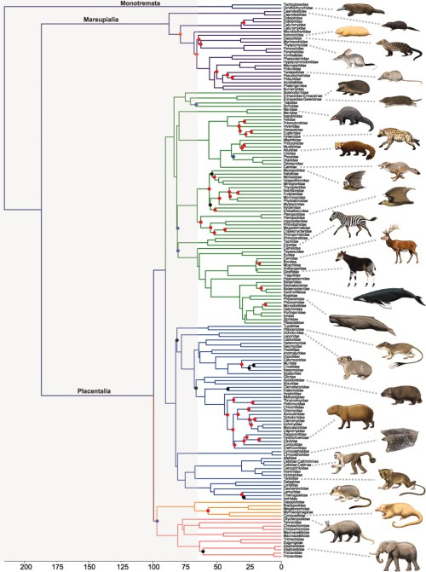
Constructing Synteny Blocks and Reconstructing Rearrangement History of All Mammals
Science,
February, 2013
Notes:
# clumps of b.p. w/in .668 Mb in uniform distrib expected to be 43, vs. our 190 b.p. re-uses.

